Slide 1

AdriaFirePropagator – basic functionalities
Split - Dalmatia County
FESB University of Split

Slide 2

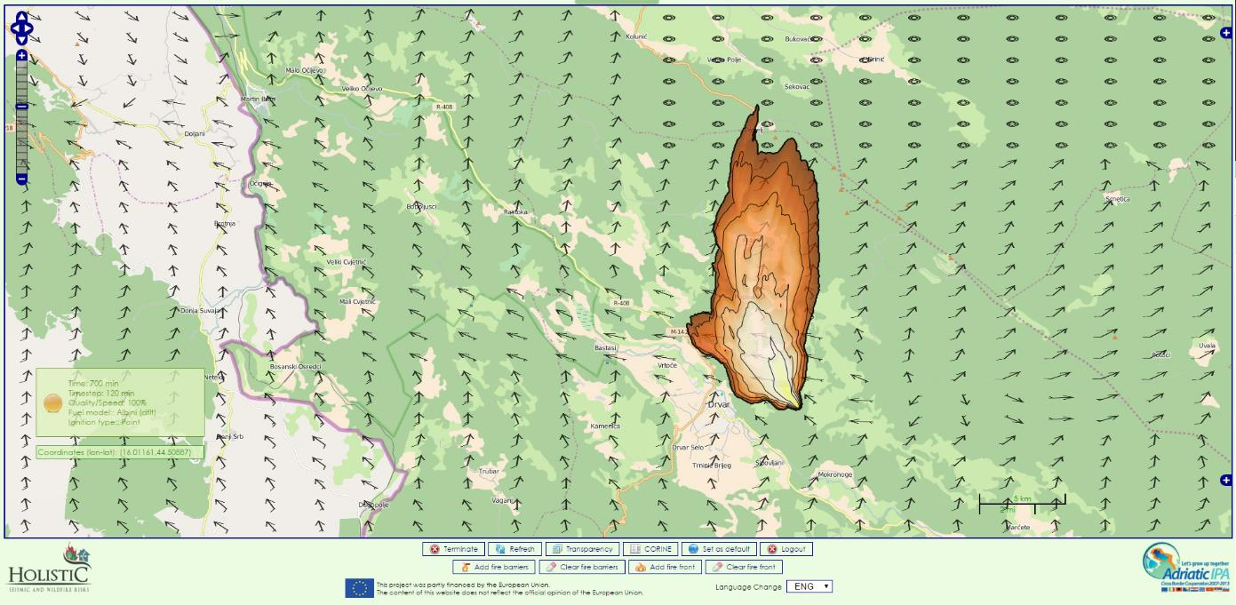
AdriaFirePropagator

Slide 3
AdriaFirePropagator
Starting simulations with custom conditions

Slide 4
AdriaFirePropagator
Setting wind conditions

Slide 5
AdriaFirePropagator
Wind parameters:
    On-line
    Meteo
    ASC
    Value
    By Date

Slide 6
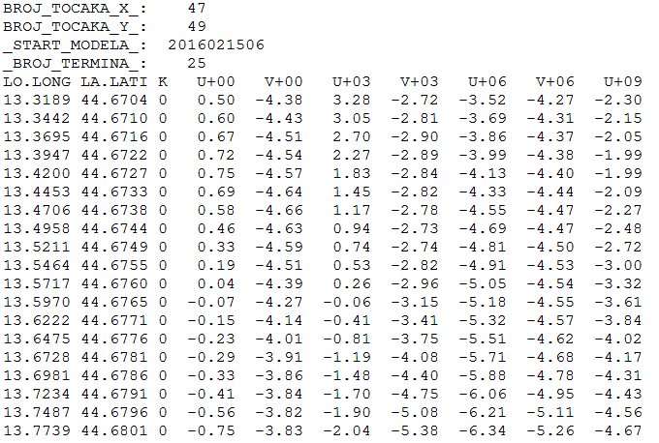
AdriaFirePropagator
Wind parameters:
    On-line
    Meteo
    ASC
    Value
    By Date

Slide 7
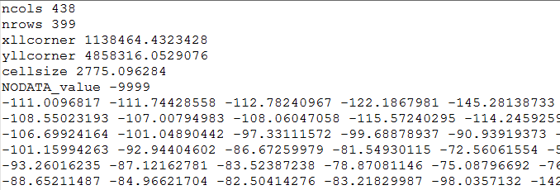
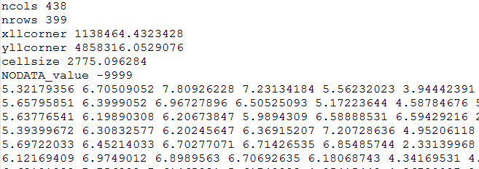
AdriaFirePropagator
Wind parameters:
    On-line
    Meteo
    ASC
    Value
    By Date

Slide 8
AdriaFirePropagator
Setting moisture conditions

Slide 9
AdriaFirePropagator
Moisture parameters:
    On-line
    ASC
    Value
    By Date

Slide 10
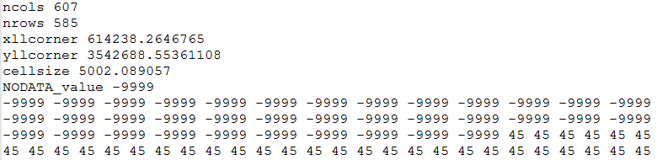
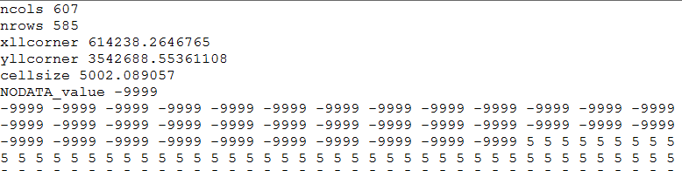
AdriaFirePropagator
Moisture parameters:
    On-line
    ASC
    Value
    By Date

Slide 11
AdriaFirePropagator
Moisture parameters:
    mois_live
      1-hour (<.25") fuel moisture (%)
    mois1h
      1-hour (.25-1") fuel moisture (%)
    mois10h
      1-hour (<.25") fuel moisture (%)
    mois100h
      1-hour (1-3") fuel moisture (%)

Slide 12
AdriaFirePropagator
Setting fuel parameters

Slide 13
AdriaFirePropagator
Fuel parameters:
    1-h Fuel Load
    10-h Fuel Load
    100-h Fuel Load
    Live Herbaceous Fuel Load
    Live Woody Fuel Load
    1-h Surface Area/Vol Ratio
    Live Herbaceous Surface Area/Vol Ratio
    Live Woody Surface Area/Vol Ratio
    Fuel Bed Depth
    Dead Fuel Moisture of Extinction
    Dead Fuel Heat Content
    Live Fuel Heat Content

Slide 14
AdriaFirePropagator
1-h Fuel Load
- weight of the 1-h dead fuel per unit area
10-h Fuel Load
100-h Fuel Load
Live Herbaceous Fuel Load
Live Woody Fuel Load
1-h Surface Area/Vol Ratio
- the amount of area on the outside of the fuel divided by the volume of the fuel
Live Herbaceous Surface Area/Vol Ratio
Live Woody Surface Area/Vol Ratio
Fuel Bed Depth
- depth of the surface fuel
Dead Fuel Moisture of Extinction
- characteristic Dead Fuel Moisture where a predictable steady state rate of fire spread is not attainable
Dead Fuel Heat Content
- the amount of heat energy contained in a unit of fuels
Live Fuel Heat Content
- the amount of heat energy contained in a unit of fuels

Slide 15
AdriaFirePropagator
Fire fronts

Slide 16
AdriaFirePropagator
Fire barriers

Slide 17
AdriaFirePropagator

Slide 18
AdriaFirePropagator
Fuel parameters:
    1-h Fuel Load
    10-h Fuel Load
    100-h Fuel Load
    Live Herbaceous Fuel Load
    Live Woody Fuel Load
    1-h Surface Area/Vol Ratio
    Live Herbaceous Surface Area/Vol Ratio
    Live Woody Surface Area/Vol Ratio
    Fuel Bed Depth
    Dead Fuel Moisture of Extinction
    Dead Fuel Heat Content
    Live Fuel Heat Content

